Slide 1
TEAM LEAD: VAIBHAV SHETH
TEAM MEMBER: NIDHI KOTAK
ERROR CODE 42
Notes:
Amity Business School

Slide 2
SMART WATER BOTTLE Attachment
(that will track when you take a sip of water and remind you to drink more (by blinking) before dehydration kicks in. )
Notes:
Amity Business School

Slide 3
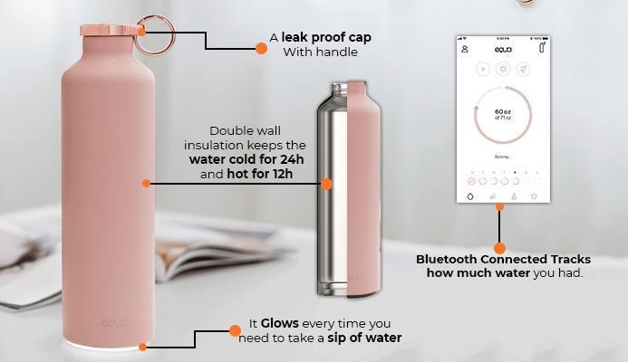

Slide 4
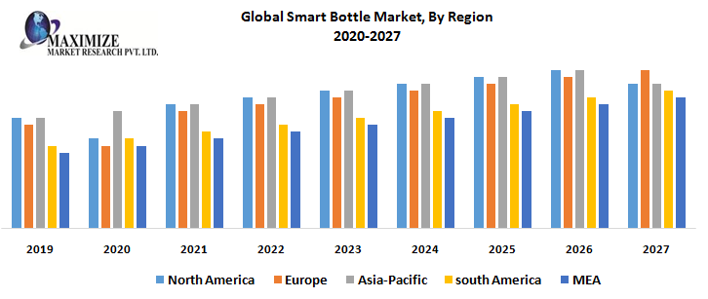
Market Forecast on Growth (based on research paper referred)
The global smart water bottle market is expected to grow at a CAGR of 15.2% over the forecast period i.e. 2017-2024. Further, smart water bottle market is anticipated to reach USD 238 Million globally by 2024.
Notes:
Amity Business School

Slide 5
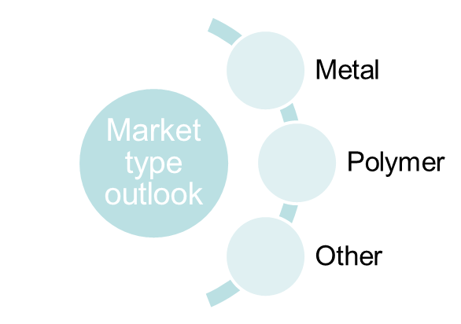
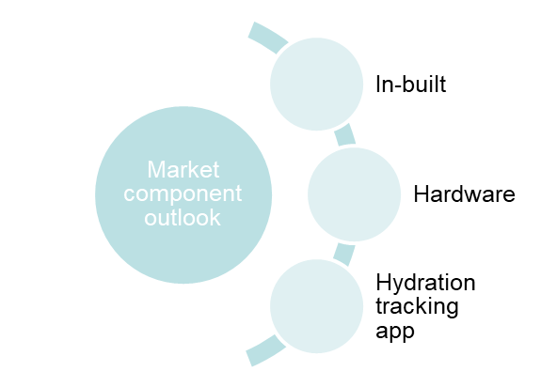
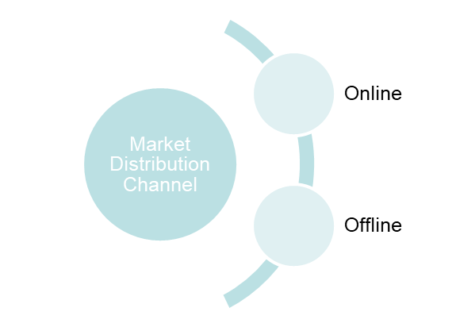
Market Segmentation

Slide 6
Market Targeting
Marketing Objectives:
To reach out to kids aged between 8-16 years and Young Women aged between 25-35.
Create awareness in Urban market about drinking water timely, and positioning our smart water bottle as its modern approach to stay hydrate.
College students, as they are more caring for themselves regarding health
Promote Green India, as smart water bottle is a green solution for society and its health concious. Which will create a “FOR SOCIAL CAUSE” effect psychologically.

Slide 7
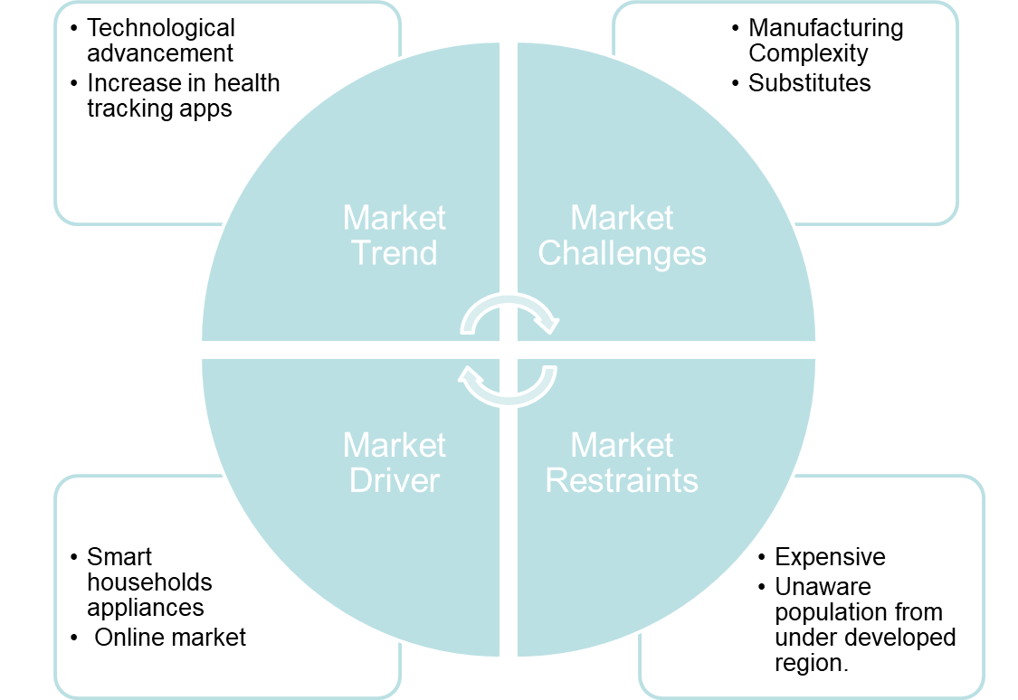
BRAND POSITIONING

Slide 8
Marketing Campaign
Run a marketing campaign under “Water that makes you smart”
Promoting Ideas (Reliable, implacable and very active campaigns)
Guerrilla marketing: for campaign at india’s busiest railway stations.
OOH marketing: Free refill stations that promotes our smart water bottle, techfests, presence in various global summit.
Strong social media penetration strategy by fixing time and date for promotion of product.
Magazine ads to penetrate into urban market.
TV reality shows, using our product on judges desks and participants regular usage.

Slide 9
Error code 42
VAIBHAV SHETH NIDHI KOTAK
Jury
Q&A
Notes:
Amity Business School

